Slide 1
Year 11 Study Skills

Slide 2
Year 11 Study Skills
By the end of this session, we will all know how to study successfully by:
Remembering what we know about our brain preferences
Recapping strategies for how I study
Reassuring each other of how this is manageable,
what time is available
Realising what I could achieve

Slide 3
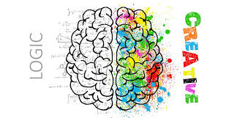
Left-brain? Right-brain?
Balanced-brain?

Slide 4
Preferred Revision Techniques
Left Brain | Right Brain
Class notes | Mind Maps
Highlight key points | Poster Diagrams
Past papers | Flash Cards
Flow charts | Comic Strips
Follow the syllabus outline / topic overviews when studying/creating notes | Video montage / raps/ songs/ poems
Bullet points/numbers/tables | Active learning

Slide 5
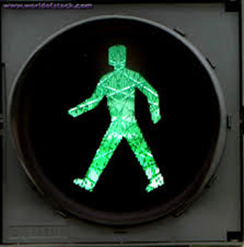
How do I study?
Get organised
Create a ‘Learning File’ for each subject
Specification
Topic overviews
Make out your own revision notes
Past Paper questions
Mark schemes

Slide 6
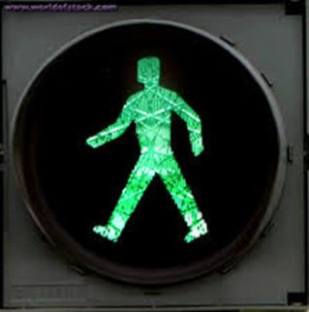
How do I study?
Know exactly …
what you are going to learn and when
Plan out a revision schedule
Use your exam timetable to help
Start with your favourite / easy subjects
Don’t forget the trickier subjects
Tick off each time you complete a session

Slide 7
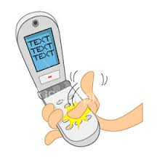
How do I study?
Get rid of distractions

Slide 8
How do I study?
Test yourself
Write key words / terms /definitions out on Post-its
Retell it in a ‘story’
Teach a friend
Prepare questions for revision classes
Learn ‘lost’ marks

Slide 9
But … do I have time to study?
This evening …
how many ½ hour study sessions can you do?
Next week?

Slide 10
Action – ready to study
Easter holidays
Take a break – everyone needs a rest
Easter Tuesday – back to the books
You should be able to set aside at least 5 days for study
at least 4 x ½ hr study sessions per day

Slide 11
Action – ready to study
Monday 9 April –
5 full weeks to the exams
At least 3 x ½ hour sessions each night
At least 4 x ½ hour sessions at the weekend

Slide 12
Action – ready to study
Adds up to 6100 minutes
or
Over 98 hours of revision!!!
And that’s not counting …
the 6 valuable lessons you have each school day!

Slide 13
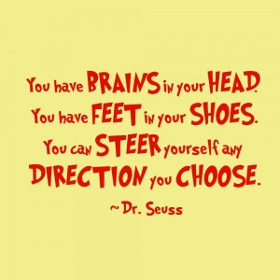
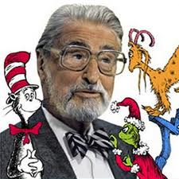
The preparation starts NOW!

Slide 14
Keep taking 5 steps to well being

Slide 15
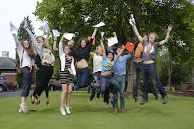
What could you achieve?

