Slide 1
(preferably google chrome)

Slide 2
Click here on View All

Slide 3
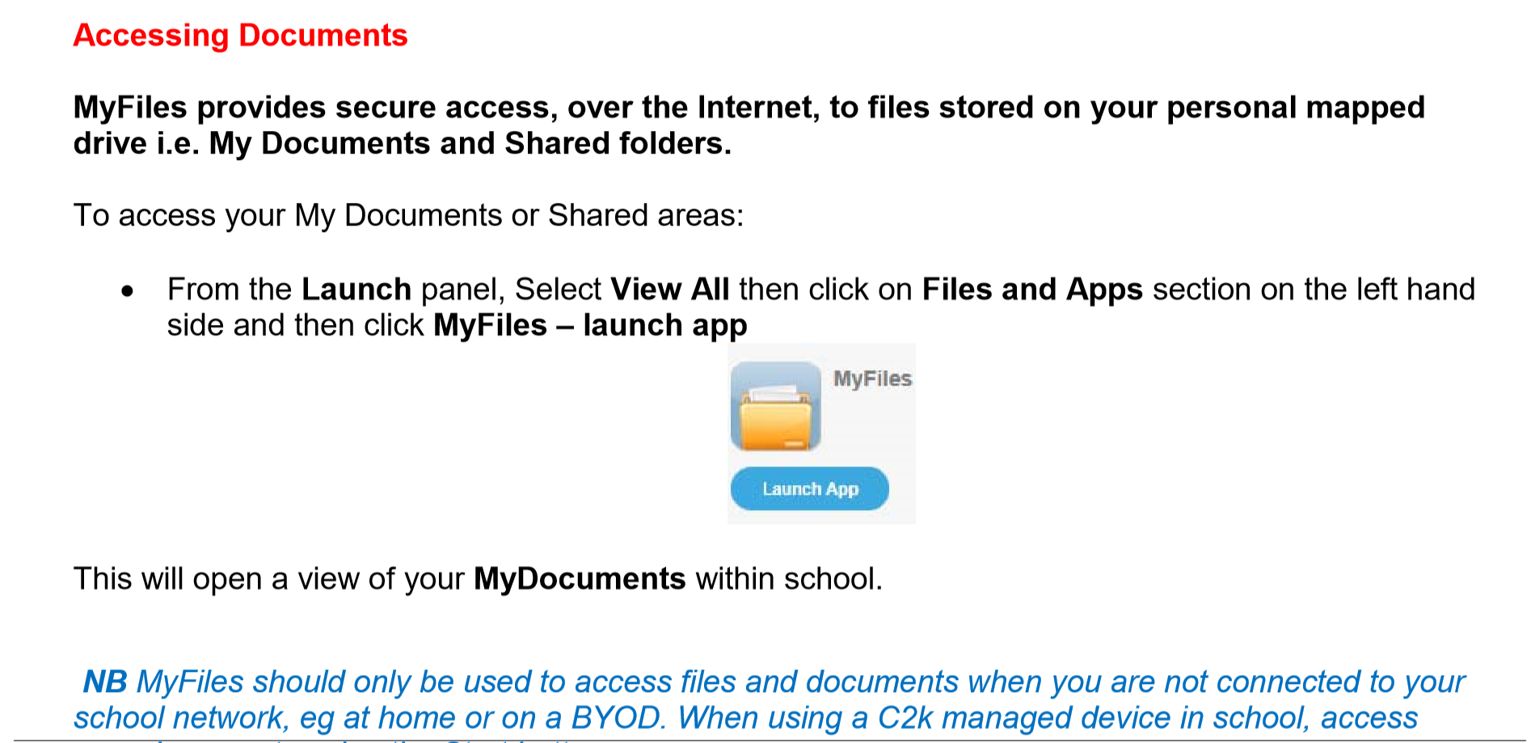
(Bring your own device – applies to sixth year students

Slide 4
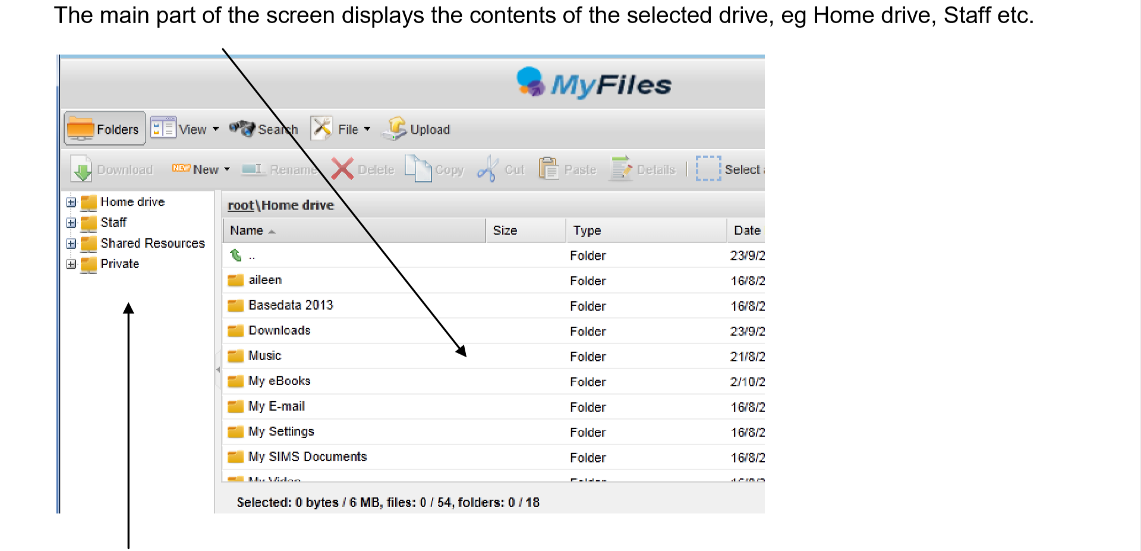
This area will be slightly different for students – you will only see your Home Drive and Shared Resources

Slide 6
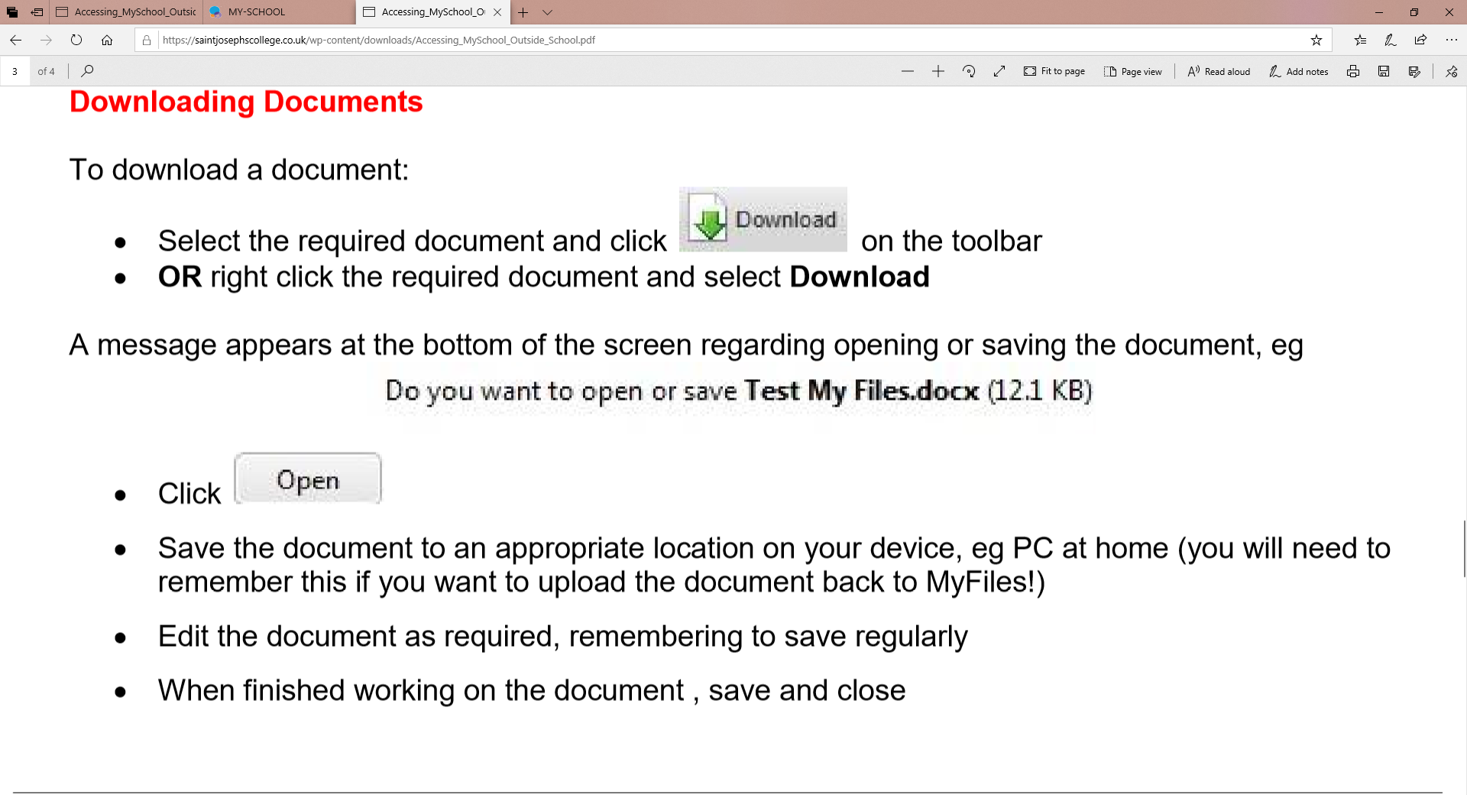
Very Important point

Slide 7
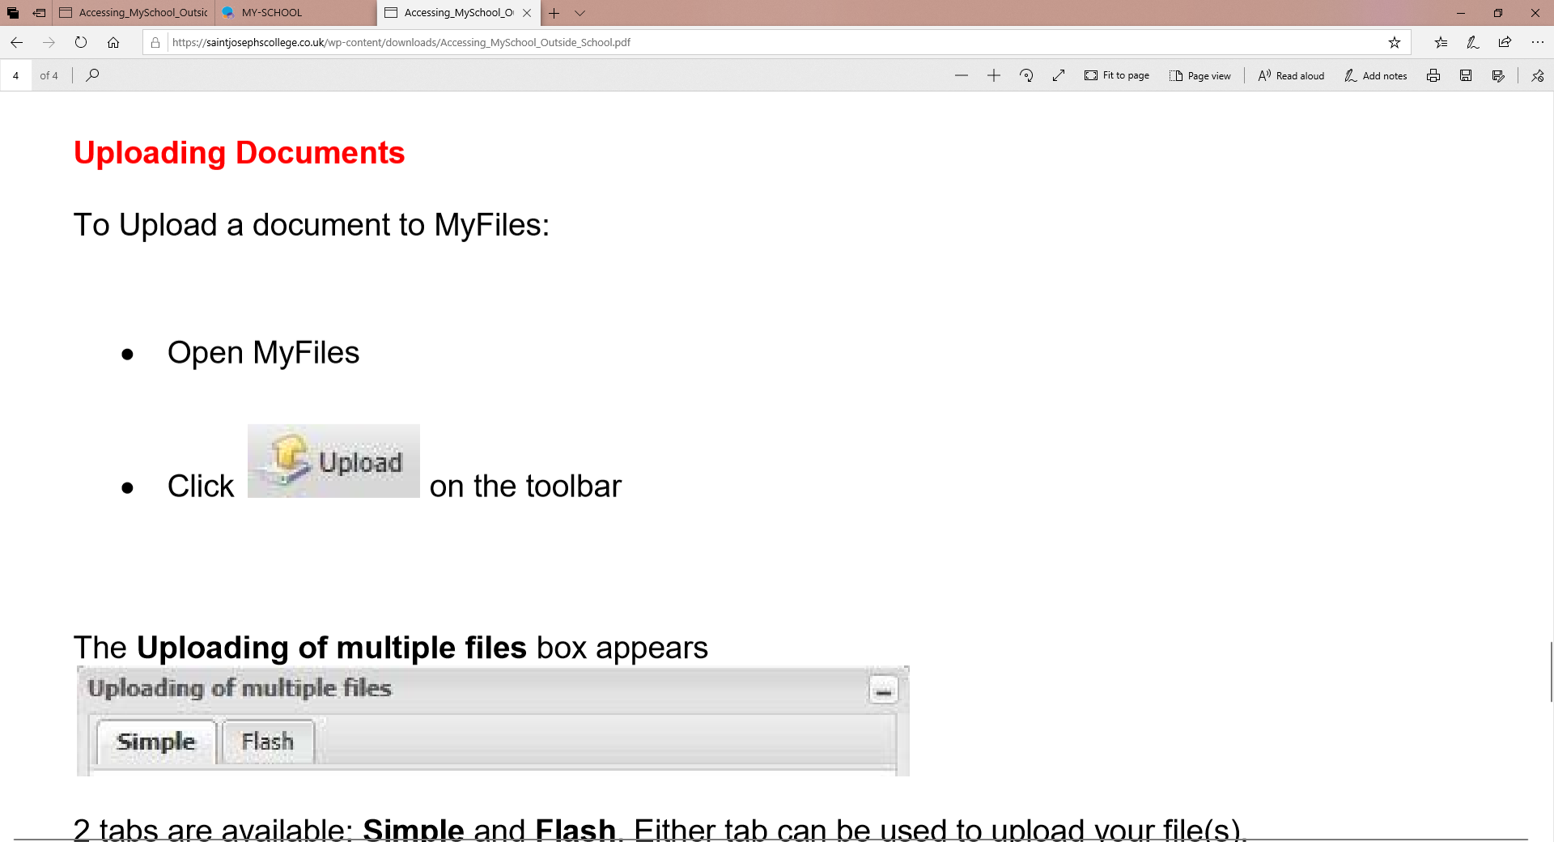

Slide 8
